Slide 1


Slide 2
objectives
Align two images of a scene along their epipolar line
Find matching point in a scene pair using feature matching algorithms.
Derive depth information from the image disparity.
Image processing techniques can be applied on videos which are essentially a series of still images.
Motion has three spatial dimensions and the fourth one is time. Non-coplanar motion and low sampling rate (fps) would affect the quality tracking.
Tracking based on color is easy but unreliable especially with the auto white-balance built in latest camera models.
Physics-301/Activity 05 - Basic Video Processing.ipynb at main · reneprincipejr/Physics-301 (github.com)
https://drive.google.com/file/d/1S1juRZtkc_vtyp8Ffvfp62fFIImtMSSb/view?usp=sharing

Slide 3
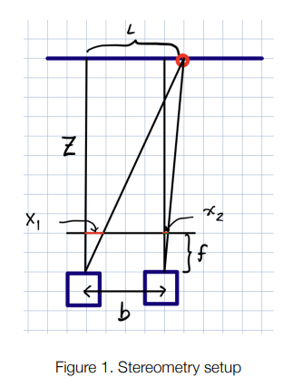
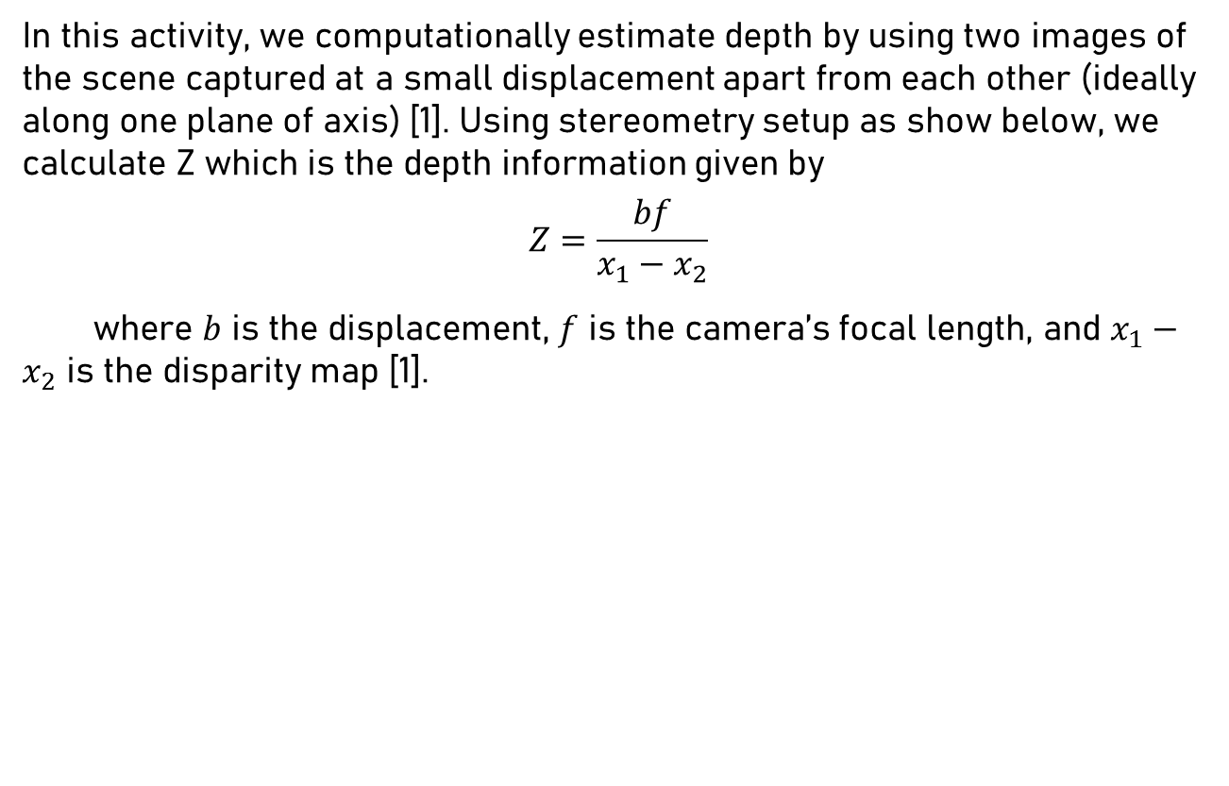
Stereometry
In this activity, we computationally estimate depth by using two images of the scene captured at a small displacement apart from each other (ideally along one plane of axis) [1]. Using stereometry setup as show below, we calculate Z which is the depth information given by
$$Z=\frac{bf}{x_{1}−x_{2}}$$
where $b$ is the displacement, $f$ is the camera’s focal length, and $x_{1}−x_{2}$ is the disparity map [1].

Slide 4
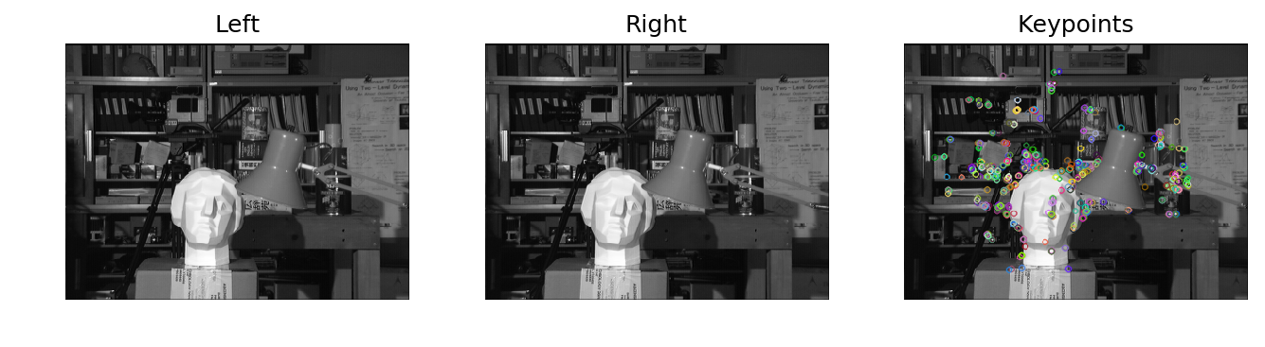
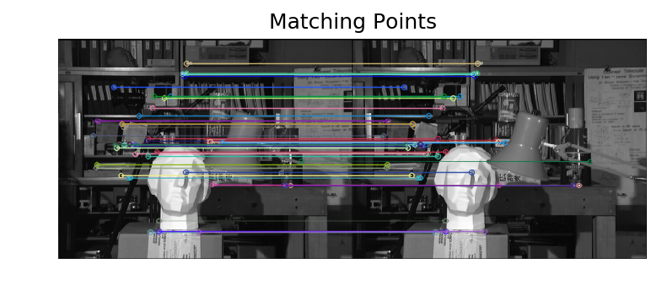
Alignment
I first performed the depth estimation on samples from Middlebury Stereo Datasets [2]. Shown below are the standard tsukubai images and the identified key points using FLANN, a fast feature detector algorithm [3].
These matching the key points shall then be used to ensure that the images are aligned and from there, we can get the camera’s Fundamental Matrix which can be used to recitify rotated images.

Slide 5
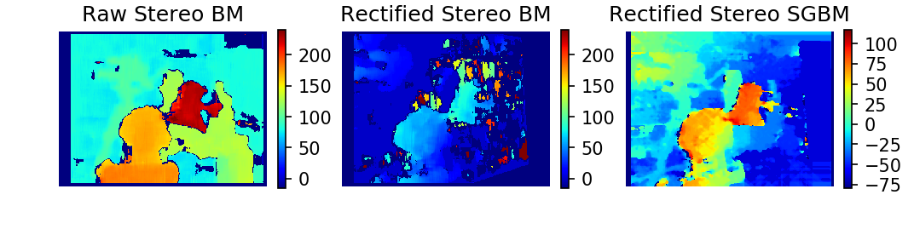
Disparity
Distorted images shall be rectified using the fundamental matrix we calculated. For uncalibrated camera, this can be done using Open-CV’s cv2.stereoRectifyUncalibrated [4]. After the necessary perspective transform, the disparity maps can be calculated using Stereo BM (block matching) algorithm [5]. In addition, we also employed Stereo SGBM (Semi-Global Block Matching) which generates a “dense and smooth” disparity map [6][7]. For visualization, we compare the disparity map calculation between the raw images, rectified images, and using the Stereo SGBM for a tuned results. The best (qualitative) disparity map shall then be 3D reconstructed and in our experimental images, we then estimate the depth.

Slide 6
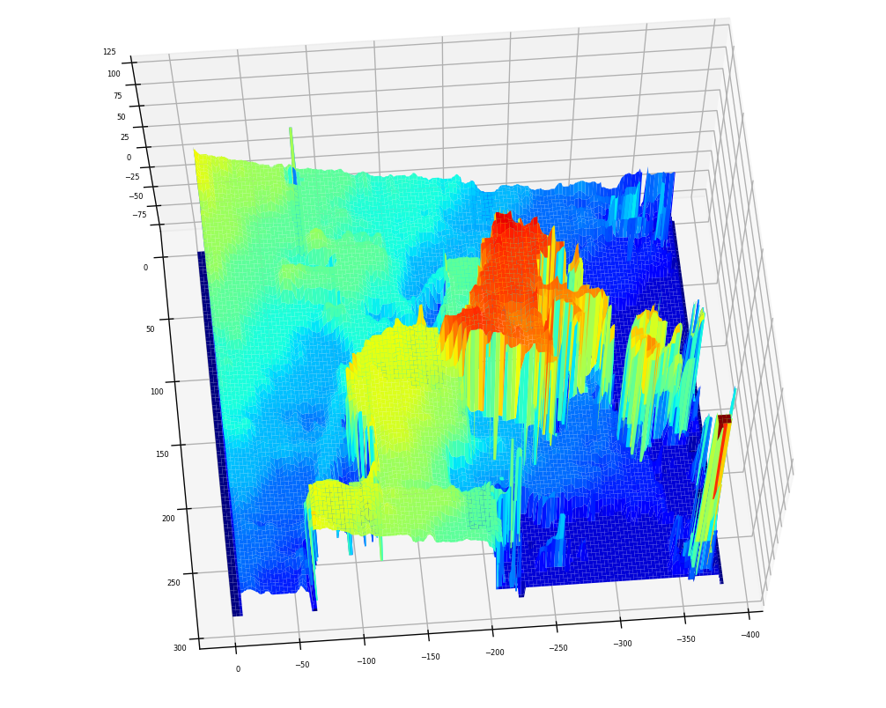
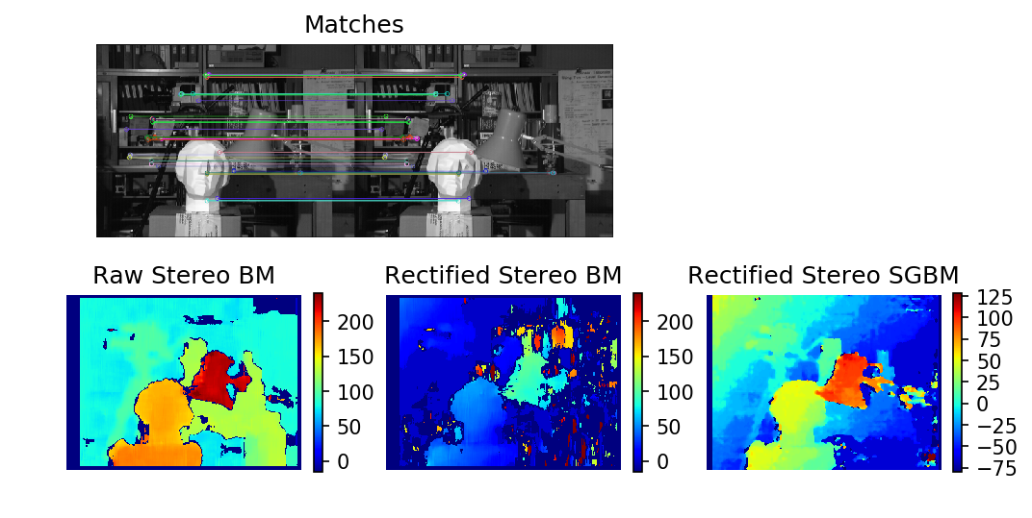
3D: Tsukuba ^{[2]}
Shown on the right is the 3D rendition of the disparity map using the rectified Stereo SGBM algorithm. Compared to the stereometry using raw images, its disparity map has smoother transitions. The lamp had greater disparity since it is nearer.

Slide 7
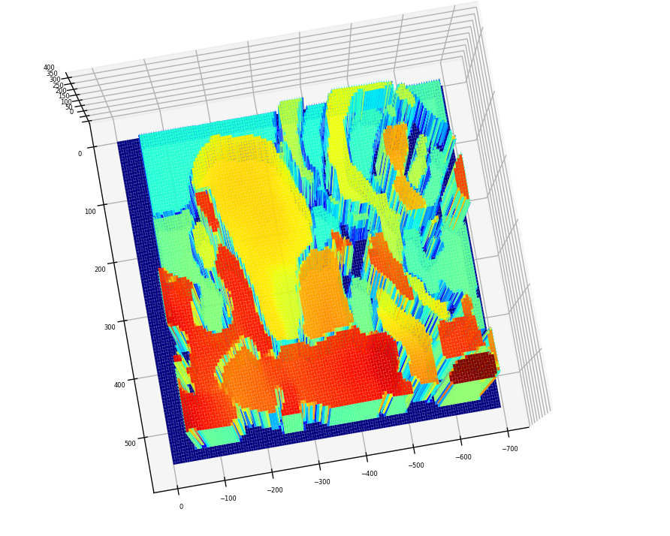
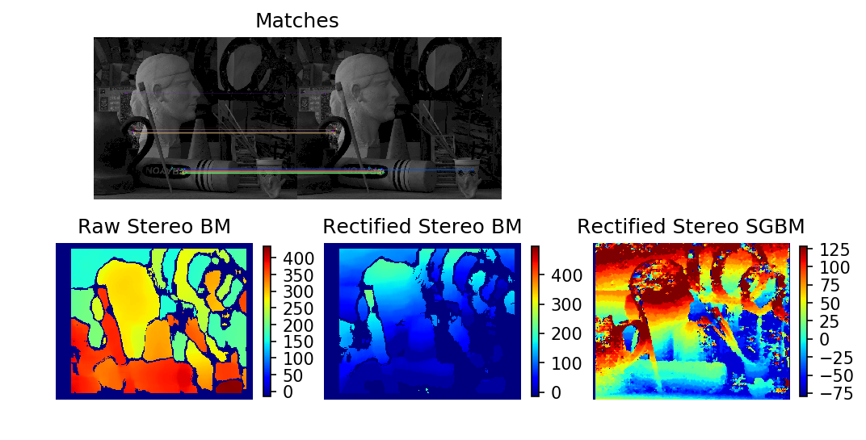
3D: Art ^{[2]}
Among the three, the Raw Stereo BM gave the best disparity map. The nearby objects show higher disparity and the objects in the background have small disparity as seen by the displaced camera.

Slide 8
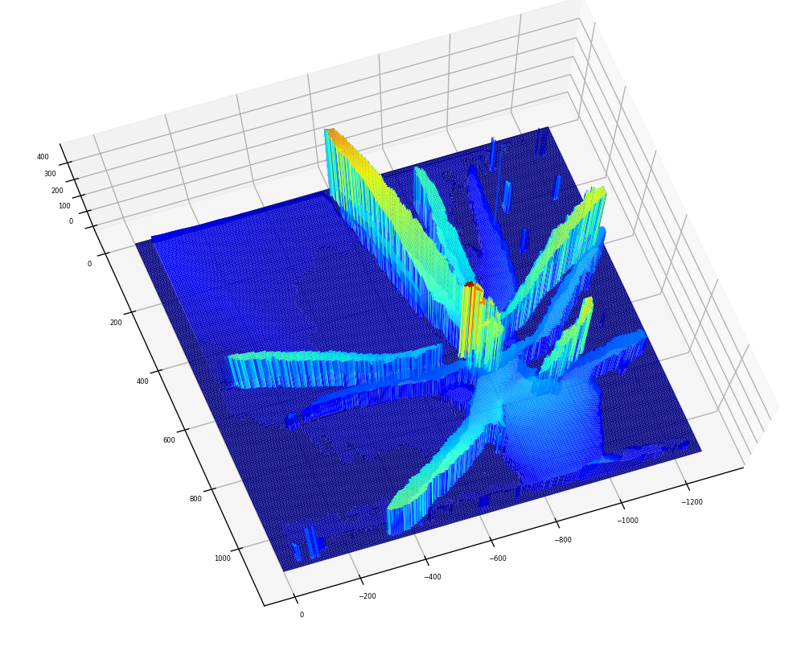
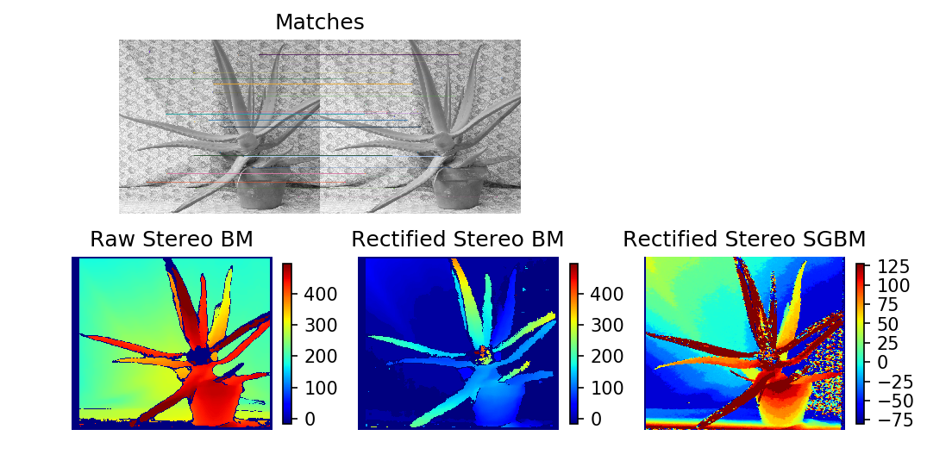
3D: Aloe Vera ^{[2]}
In this example, the rectified Stereo BM returned the best result. One leaf that’s pointed outwards was rendered with high disparity, meaning, showing that it’s nearer in the camera.

Slide 9
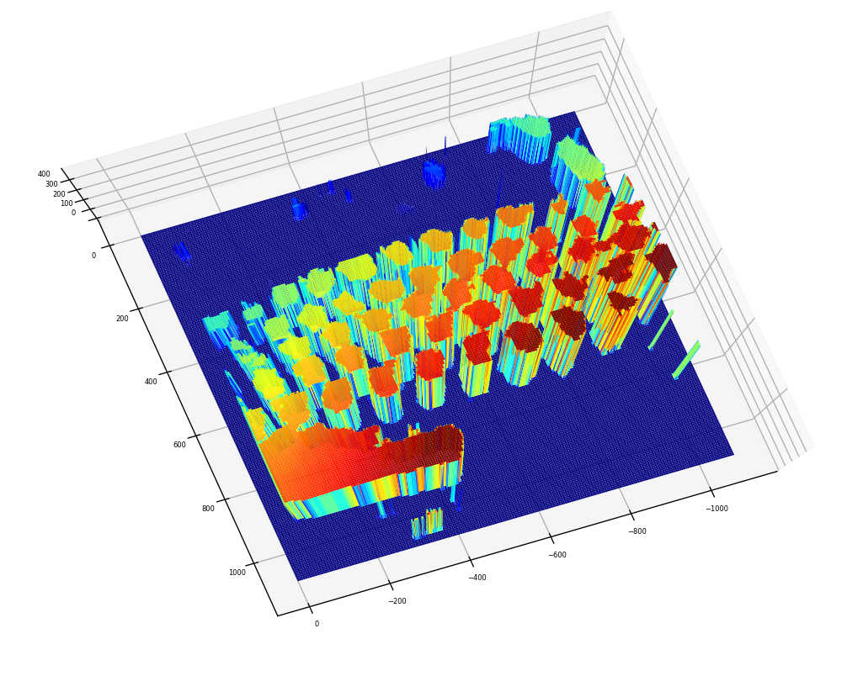
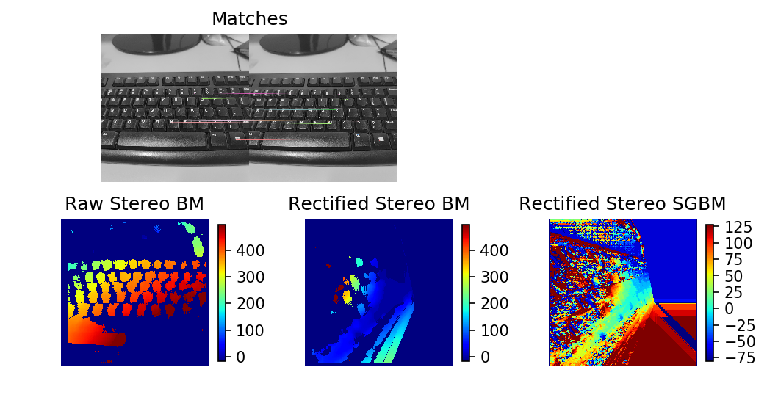
3D: Keyboard
Using images that I took; the raw disparity map was able to differentiate depth information of the keyboard caps that are nearer (red) and farther (cyan). The rectification failed in this set.

Slide 10
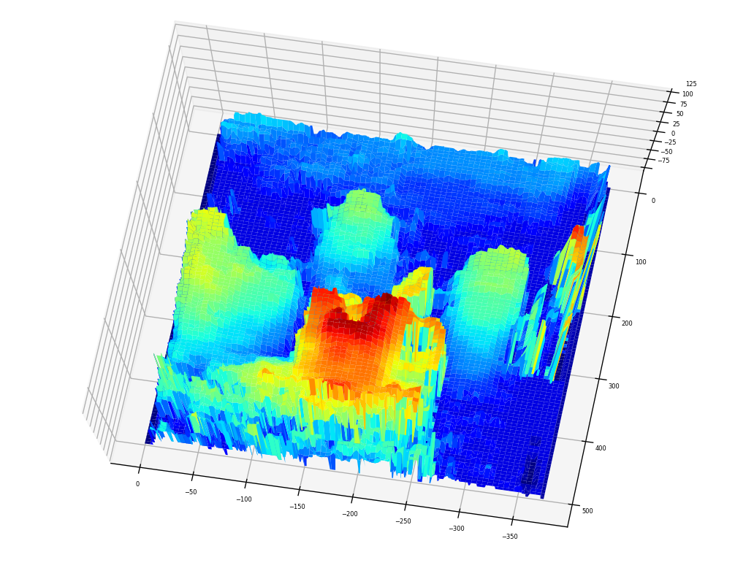
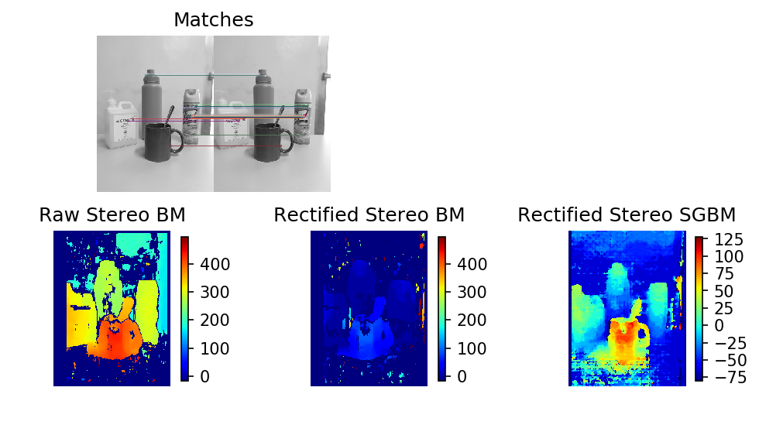
3D: Mug
For the mug, the rectified SGBM returned a good disparity map. We can see that the cup which is nearer than the rest had greater disparity. The objects at the back were also separable from the wall backdrop.

Slide 11
reflection
Overall, I enjoyed rendering the 3D objects using Stereometry. Though, a lot of trial and errors were made in terms of the parameters set which was very costly.
With that said, I’d give myself a score of 95/100.
[1] M. Soriano, Physics 301 – Shape from Stereo, (2022).
[2] vision.middlebury.edu/stereo/data
[3] Feature Matching — OpenCV-Python Tutorials beta documentation
[4] cv.stereoRectifyUncalibrated - mexopencv (amroamroamro.github.io)
[5] OpenCV: cv::StereoBM Class Reference
[6] Stereo Disparity Using Semi-Global Block Matching - MATLAB & Simulink (mathworks.com)
[7] python - OpenCV – Depth map from Uncalibrated Stereo System - Stack Overflow

